Slide 1

Advancing Child and Maternal Health: A System Dynamics Exploration of Policy Interventions to Tackle Socioeconomic Disparities.
Ashiat Ashake Adeogun & Misagh Faezipour
College of Basic and Applied Sciences, Healthcare Informatics & Department of Engineering Technology, Middle Tennessee State University, Murfreesboro, Tn, United States.
Email:aaa2ev@mtmail.mtsu.edu, misagh.faezipour@mtsu.edu
The 2023 International Conference on Computational Science and Computational Intelligence (CSCI'23)
Research Track on Health Informatics and Medical Systems (CSCI-RTHI)
Systems
Engineering Lab (SEL)

Slide 2


Research Objectives
This study analyzes the dynamic interconnections between socioeconomic inequality, policy interventions, and child and maternal health outcomes.
Learn about the system's intricate relationships and feedback loops, such as socioeconomic inequities, governmental initiatives, and child and maternal healthcare (CMH). Examine the effects of various policy interventions on crucial factors of CMH, such as income, education, healthcare access, and housing conditions.
A feedback loop guarantees that research informs policies, improves mother and child health, reduces inequities, and strengthens public health initiatives.
Systems
Engineering Lab (SEL)

Slide 3
Overview on Maternal and Child Healthcare
Recent maternal health programs have concentrated on removing barriers to healthcare access, mainly promoting universal health coverage (UHC), as the World Health Organization supports.
Despite being a novel strategy in developed countries, significant efforts are required to address the barriers and economic inequalities that impede healthcare access, particularly for underprivileged populations in low and middle-income countries, where severe socioeconomic disparities in maternity care utilization persist.
Systems
Engineering Lab (SEL)

Slide 4

Overview on Maternal and Child Healthcare(Contd)
Improving maternal and child health is a critical component of every society's developmental concerns.
There are numerous current initiatives to address the global, regional, and local maternal mortality concerns.
There is clear evidence of growing gaps in healthcare access to enhance maternal well-being within and among developing countries.
Improving maternal health remains a top priority in worldwide public health.
Systems
Engineering Lab (SEL)

Slide 5
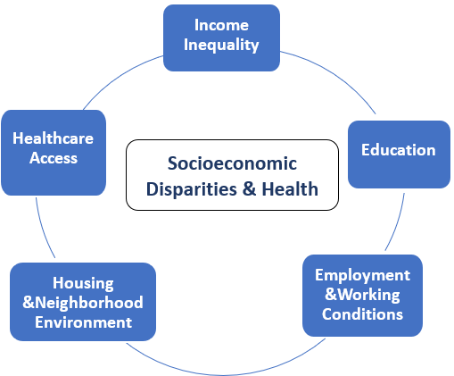
Understanding Healthcare Socioeconomic Disparities
Socioeconomic disparities persist, affecting access to resources, opportunities, and health outcomes while amplifying inequities among varied individuals and groups worldwide.
Efforts are needed to address these discrepancies and create a more egalitarian society.
Systems
Engineering Lab (SEL)

Slide 6
Policy Intervensions
Policies are legislative, administrative, and regulatory policies that shape physical activity behaviors.
They are the result of government acts or corporate laws that regulate behavior and might have intentional or unforeseen consequences.
Policy interventions have the ability to significantly reduce socioeconomic disparities in mother and child health, address essential challenges, and promote more equitable healthcare outcomes.
Systems
Engineering Lab (SEL)

Slide 7
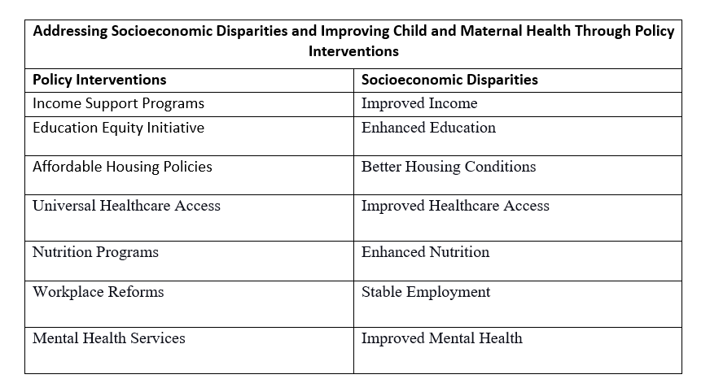
Addressing Socioeconomic Disparities and Improving Child and Maternal Health Through Policy Interventions
Systems
Engineering Lab (SEL)

Slide 8

System Dynamics Modeling
In the late 1950s, Jay Forrester invented the problem-oriented modeling technique known as system dynamics modeling to aid business managers in understanding industrial issues.
System dynamics offers a distinctive practical manifestation of these concepts through computerized models.
These models enable systematic testing of alternative policies and scenarios, providing answers to both ``what if" and ``why" questions in a structured manner.
Systems
Engineering Lab (SEL)

Slide 9
Causal Loop Model
Causal models, integral to systems thinking and dynamics, have been applied in population health since the 1970s.
Focused areas include examining interactions between healthcare system capacity, public health infrastructure, and disease epidemiology.
Causal loop models can graphically illustrate factors and their relationships in a system as causal links.
A feedback loop represents a graphical or mathematical way of illustrating the cause-and-effect relationships between variables in a system. There are two type feedback loop which are reinforcing and balancing loop.
They have accompanying signs on these links that indicate an increasing (+) or decreasing (-) relationship.
Systems
Engineering Lab (SEL)

Slide 10
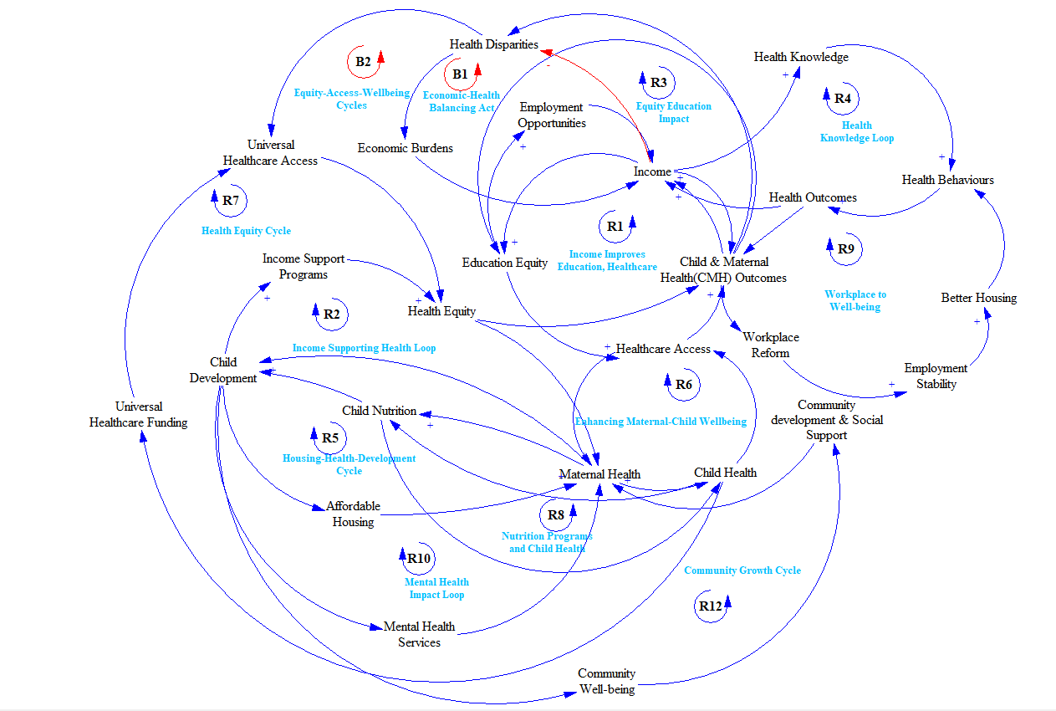
Investigating How Policy Initiatives and Socioeconomic Factors Interact to Influence Maternal and Child Health Outcomes.
Tobacco control measures
The Socioeconomic Disparities and Policy Intervention Visualization
Systems Engineering Lab

Slide 11
Causal Model Discussions
Income Improves Education, Healthcare (R1)
Income Supporting Health Loop (R2)
Equity Education Impact (R3)
Health Knowledge Loop (R4)
Housing-Health-Development Cycle (R5)
Workplace to Well-being (R9)
Mental Health Impact Loop (R11)
Economic-Health Balancing Act (B1)
Systems
Engineering Lab (SEL)

Slide 12

Conclusions
The system dynamics exploration of policy interventions for socioeconomic disparities in child and maternal health reveals complex interconnections among income, education, healthcare access, and equity.
The study emphasizes the need for well-designed policies, considering feedback loops and unintended consequences.
Future research proposes developing and enhancing a system dynamics model, incorporating new variables, and validating it with empirical data.
Scenario-based investigations can simulate policy impacts, assess model reliability, and explore long-term effects, emphasizing the importance of continued research for evidence-based strategies in addressing socioeconomic disparities and improving child and maternal health outcomes.
Systems
Engineering Lab (SEL)

Slide 13
References
ADAMS, C. A. The sustainable development goals, integrated thinking and the integrated report. Integrated Reporting (IR) (2017), 1–52.
AHMED, S., CREANGA, A. A., GILLESPIE, D. G., AND TSUI, A. O. Economic status, education and empowerment: implications for maternal health service utilization in developing countries. PloS one 5, 6 (2010), e11190.
ANDREWS, E. L. Economic inequality grew in 90’s boom, fed reports. New York Times 23, 01 (2003).
ANDRULIS, D. P. Access to care is the centerpiece in the elimination of socioeconomic disparities in health. Annals of internal medicine 129, 5 (1998), 412–416.
BARASA, E. W., CLOETE, K., AND GILSON, L. From bouncing back, to nurturing emergence: reframing the concept of resilience in health systems strengthening. Health policy and planning 32, suppl 3 (2017), iii91–iii94.
BRADMAN, A., CHEVRIER, J., TAGER, I., LIPSETT, M., SEDGWICK, J., MACHER, J., VARGAS, A. B., CABRERA, E. B., CAMACHO, J. M., WELDON, R., ET AL. Association of housing disrepair indicators with cockroach and rodent infestations in a cohort of pregnant latina women and their children. Environmental health perspectives 113, 12 (2005), 1795–1801.
Systems
Engineering Lab (SEL)

Slide 14

Systems
Engineering Lab (SEL)

